Slide 1
SUB. CODE: UIT1401
TITLE: PRINCIPLES OF SOFTWARE ENGINEERING
Prepared By: Dr.V.Arulkumar, Asst.Prof, IT

Slide 2
COURSE OBJECTIVES
● To understand the process and its models.
● To understand fundamental concepts of requirements engineering and Analysis Modelling.
● To understand the major considerations for enterprise integration and deployment.
● To learn various testing and maintenance measures.

Slide 3
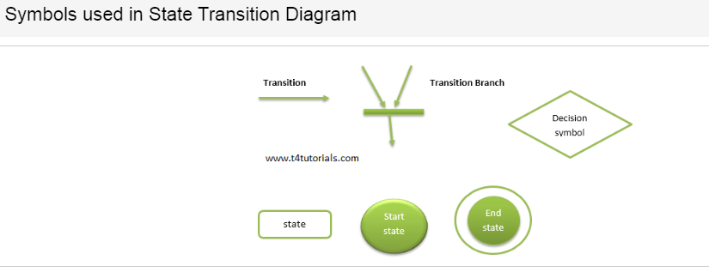
STATE TRANSITION DIAGRAM
State Transition Diagram:
When we write our program in Object-oriented programming, then we need
to take classes and objects. Objects change their states during different
functions/actions performed on objects.
In a state transition diagram, the states appear as rounded rectangles with
the state names inside.

Slide 4
TERMINOLOGIES OF STATE TRANSITION DIAGRAM
State
In the state transition diagram, An object always remains in some state. Further, the state of the object may change after an event occur.
Event
Any activity that may trigger a state transition or can change the state.
Guard
In the state transition diagram, a guard is a boolean expression. Suppose if the guard is true, then it enables an event to trigger a transition.
Transition
The change of state within an object is represented with a transition. It is possible that an object changes its state when the transition occurs.
Action
One or more actions are taken by an object when the object changes a state.

Slide 5
EXAMPLES OF STATE TRANSITION DIAGRAM
Case Study:
You need to develop a web-based application in such a way that users can search other users, and after getting search complete, the user can send the friend request to other users. If the request is accepted, then both users are added to the friend list of each other. If one user does not accept the friend request. The second user can send another friend request. The user can also block each other.
Solution:
First of all, identify the object that you will create during the development of classes in oop
Identify the actions or events
Identify the possible states for an object
Draw the diagram.

Slide 6
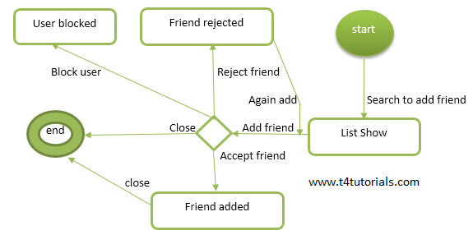
Object: friends
Events or actions: Search to add a friend, add a friend, accept a friend, reject a friend, again add, block user and close.
States: Start, the friend added, friend rejected, user blocked and end.

Slide 7
ADVANTAGES OF STATE TRANSITION DIAGRAM
A state transition diagram is used to represent a finite state machine.
A state transition diagram is a demonstration of how our objects and functions behave within the system.
WHEN I CAN USE STATE TRANSITION DIAGRAM
When the system has some dependencies on the events or on the values in the past.
State Transition diagram can be used when a software tester is testing the system for a finite set of input values.
When the software tester focus is to understand the behavior of the object.
When the software tester focus is to test the sequence of events that may occur in the system under test.

Slide 8
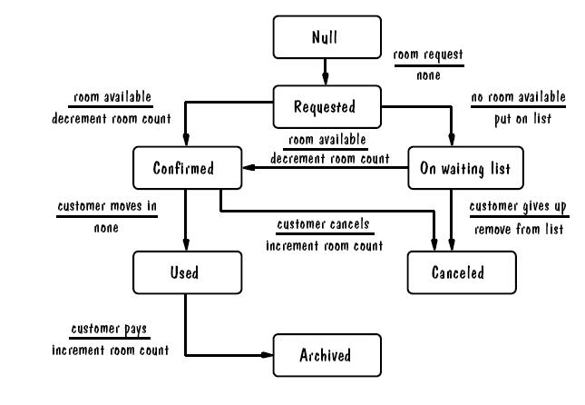
TRANSITION DIAGRAM FOR HOTEL ROOM RESERVATION

Slide 9
REFERENCE
Roger S. Pressman, Software Engineering – A practitioner’s Approach, Seventh Edition, McGraw-Hill International Edition, 2010.
Ian Sommerville, Software Engineering, 9th Edition, Pearson Education Asia, 2011.

